Slide 1
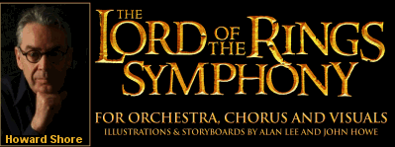
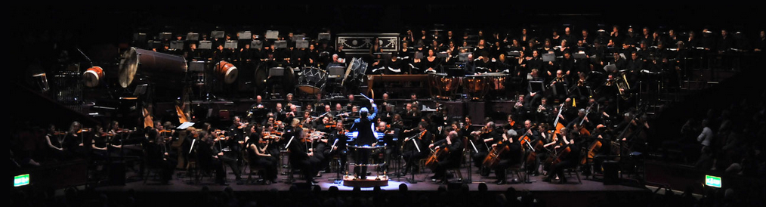
The making of the promotional poster for Howard Shore and his Orchestra.
Best known for his works heard within the movies The Hobbit and The Lord of the Rings.

Slide 2
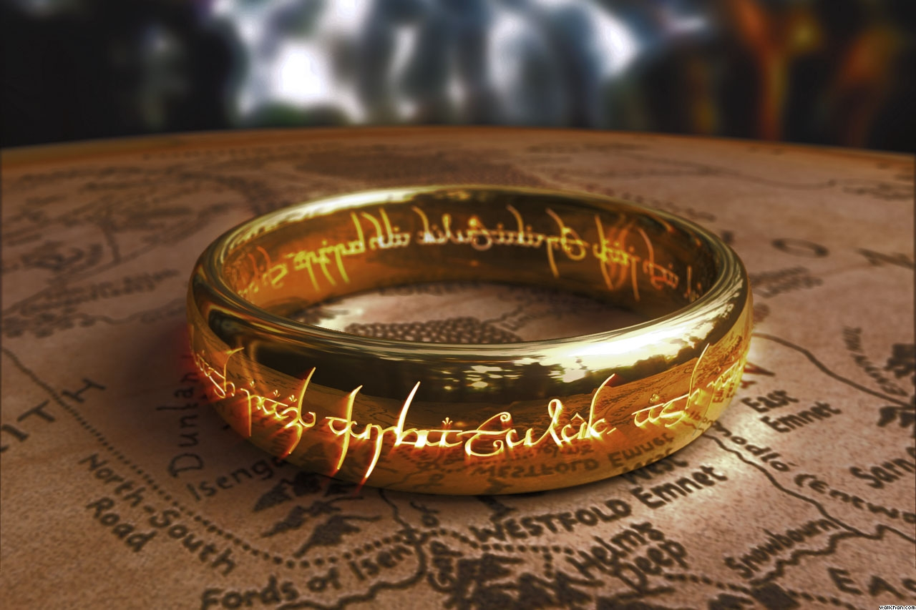
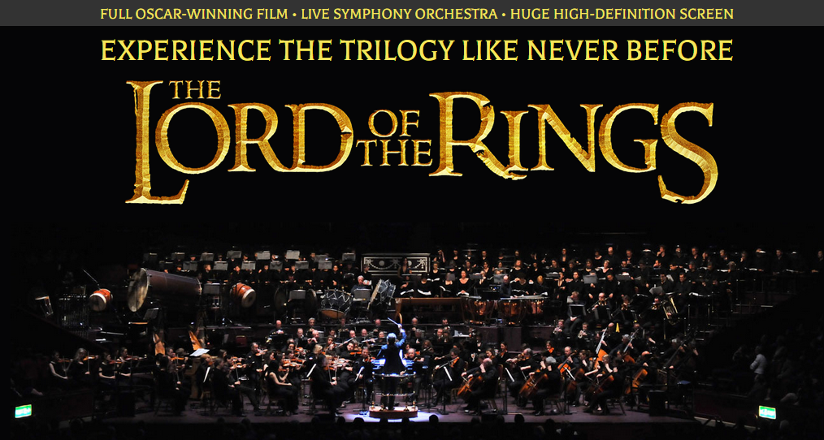
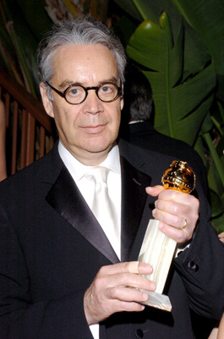
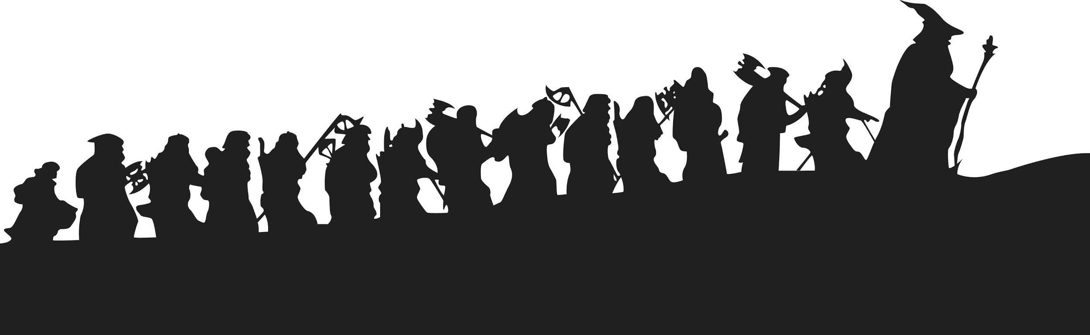
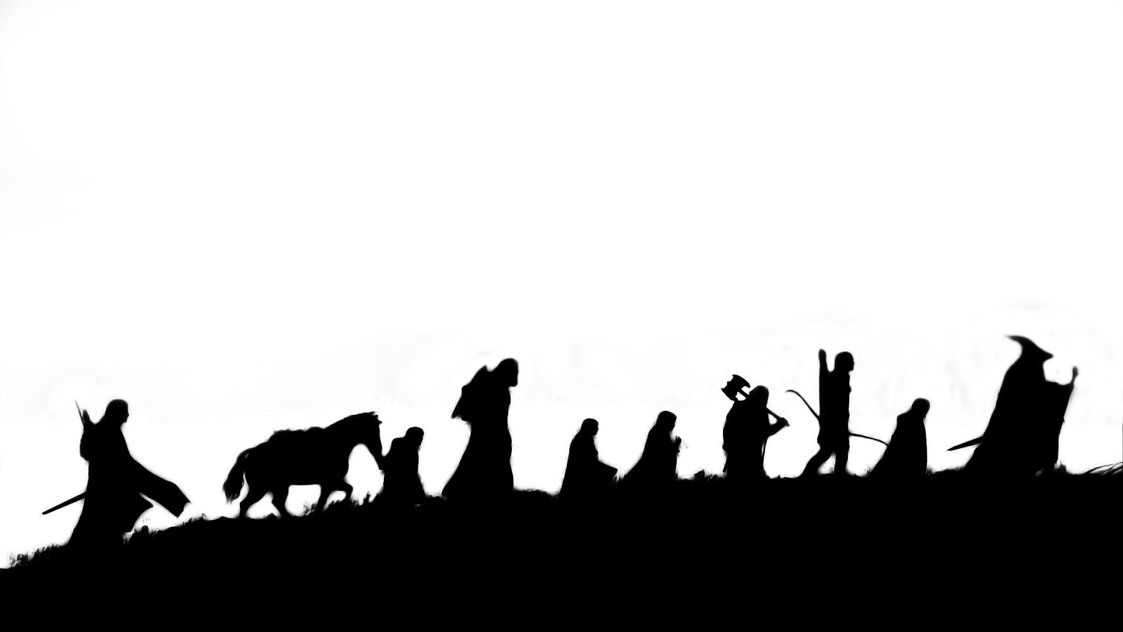
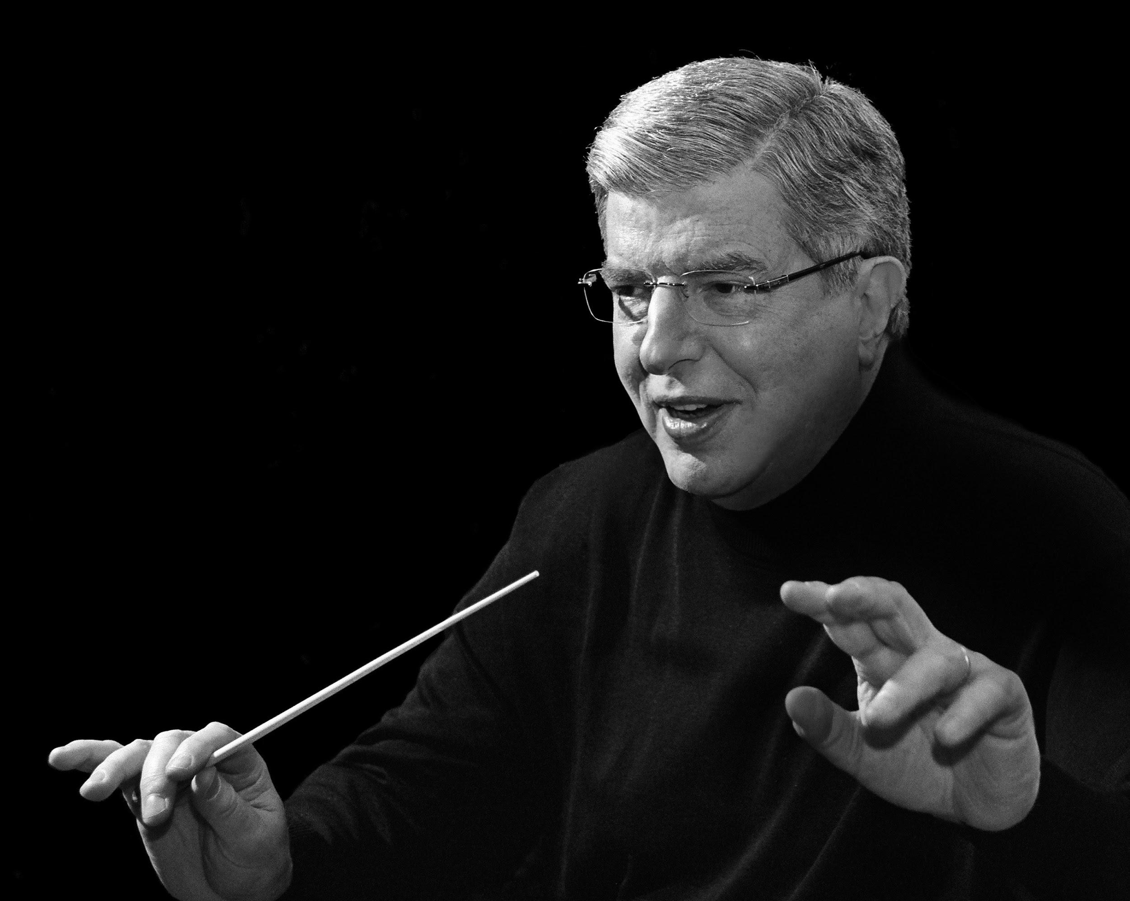
First, collecting images
I have collected the following to use in the poster.

Slide 3
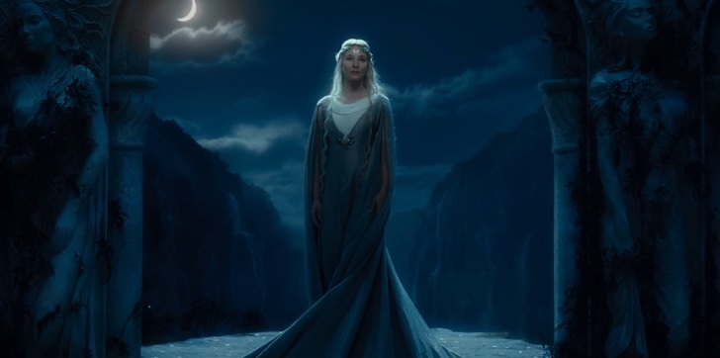
Collecting images continued

Slide 4
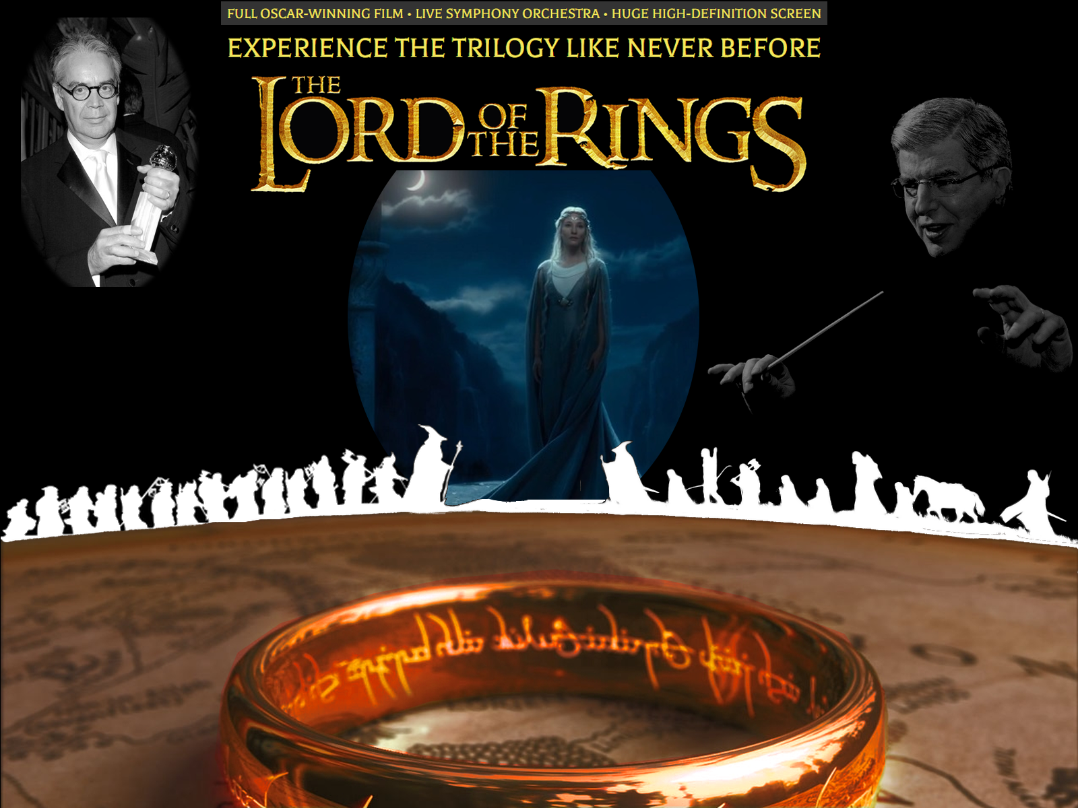
Second, finished look for a guide

Slide 5
Third, a blank canvas
Lets start the GIMP graphic with a 1600x1200 size, with a black background.
To help line things up, please put a guideline in the vertical center(at the 800 mark). Add another at the horizontal 820 mark. This latter one will be used to guide the top edge of the map layer, as well as to line up the two silhouettes images with each other.

Slide 6
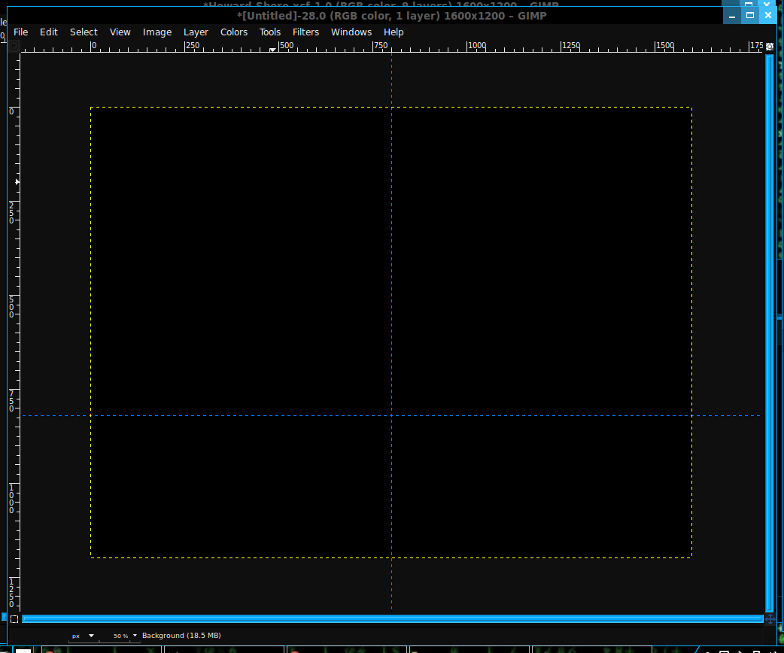
Third, a blank canvas continued

Slide 7
Fourth, the One Ring
We’ll add the map with the ring on it as a bottom image. This will need to altered as the background is not needed.
From now on, when adding a layer, assume you need to add the Alpha Channel to it. So, File->Open as Layers, then open the map image.
I used the Paths tool and outlined the background then Cleared it. Then I used the Layer->Autocrop to shorten the layer border.
We now need to Scale it to fit the Canvas and then center it so the top of the layer is there abouts the horizontal guideline(you may need to make fine adjustments yourself).

Slide 8
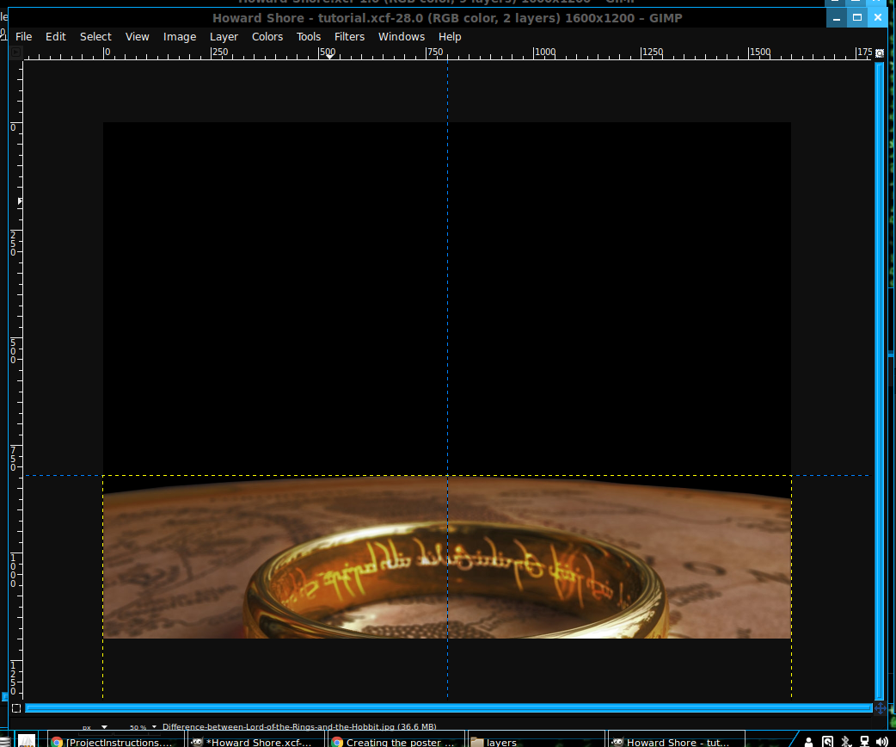
Fourth, the One Ring continued

Slide 9
Fifth, Silhouettes
I have two images of silhouettes, one from the Hobbit and the other from The Lord of the Rings. Since the Hobbit was first in the series, I placed it on the left side.
Open both images as layers and scale the widths down to 750px. The Lord of the Rings layer needs to be flipped so both parties are facing each other.
You will notice the coloring is off. On both images, invert the colors so we have White dwarfs on a dark background. Then select all the non White colors and clear them into transparency. Make sure the White IS White. Select all the people and paint fill it with color White.

Slide 10
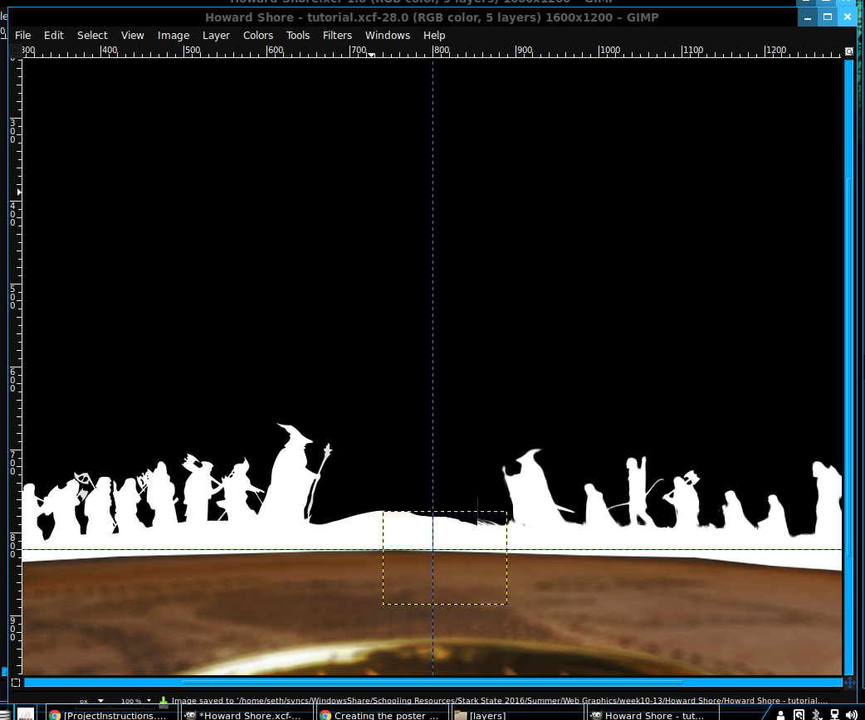
Fifth, Silhouettes continued
Arrange the layers so they are behind the map and on the canvas so it appears they are marching along the edge.
You will notice a gap between the two layers. I simply created a new layer with White fill. I placed it between them to bridge the land. Then I took the Eraser tool and adjusted the look so it was not so blocky.

Slide 11
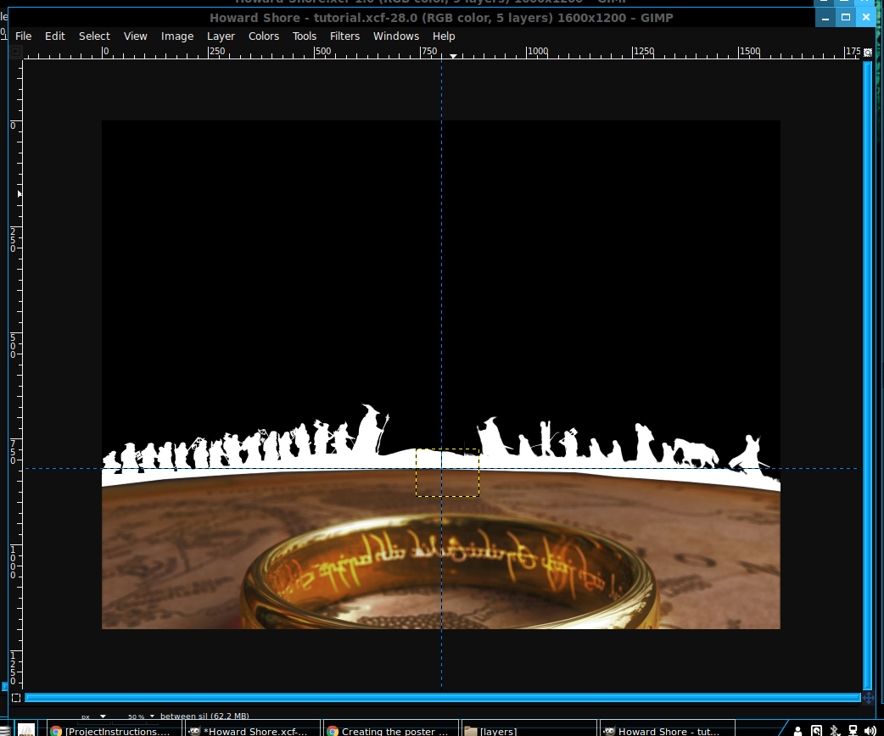
Fifth, Silhouettes continued

Slide 12
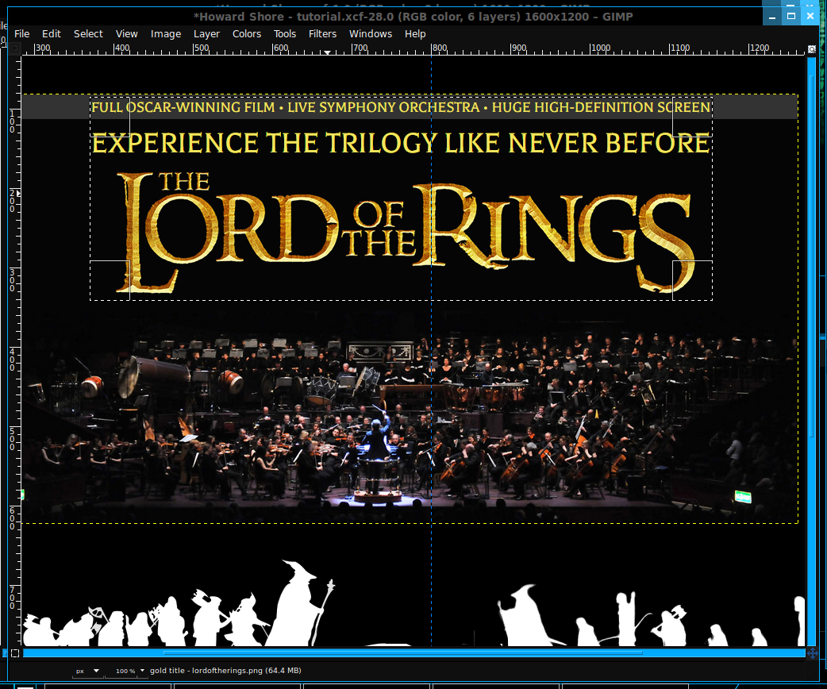
Sixth, Adding a title
This one is easy. We just need to cut out the title and paste it center in the top of the canvas.

Slide 13
Sixth, Adding a title continued
Throw a square select around the title and then invert the selection. This will select everything but the title. Then clear it to remove the extra imagery from the layer. Then autocrop the layer and I then scaled the width to 900px to make it a suitable size. Finally, move it to the top center position on the canvas.

Slide 14
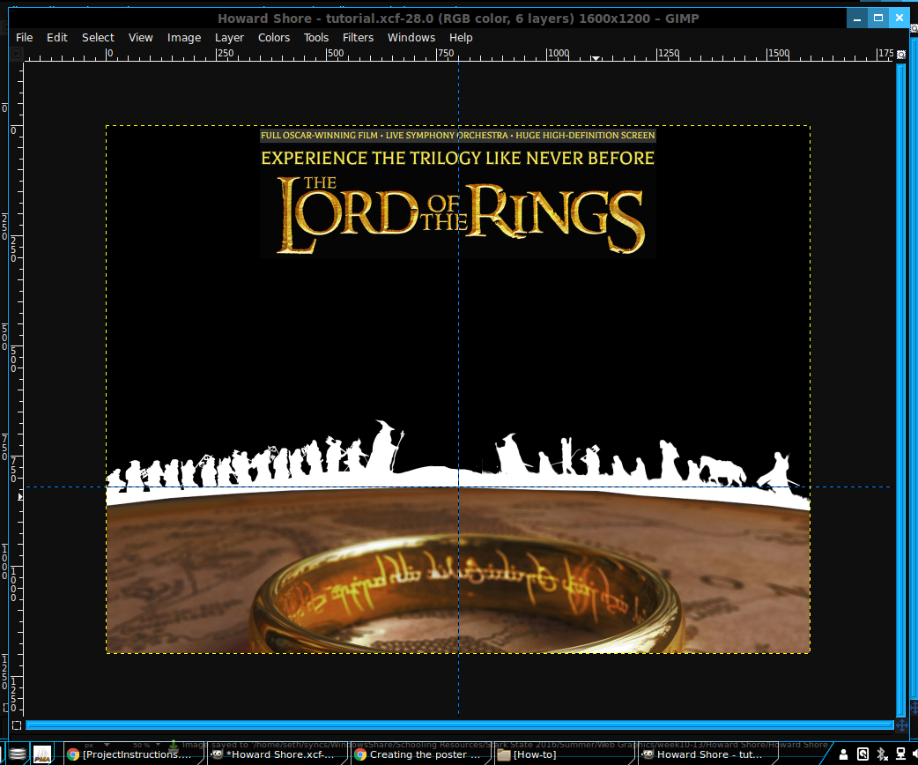
Sixth, Adding a title continued

Slide 15
Seventh, Adding Howard Shore
I have two images of him. One is showing him holding an award, another of him conducting with his wand. For both images I want them to be in the background a bit. So, I made them grayscale and off to the sides.
Lets open as a layer the Howard Shore conducting. It is a very large photo, so scale it down to 650px in width. Then go into the Colors menu and Brightness-Contrast. I had mine set to Brightness: -127 & Contrast 14. Play with it as you like.
After that, select all the black in the layer and clear it to transparency.
Finally, move the layer so his left hand is on the canvas edge and the top of his head is in line with the top edge of the word “Rings” in the title.

Slide 16
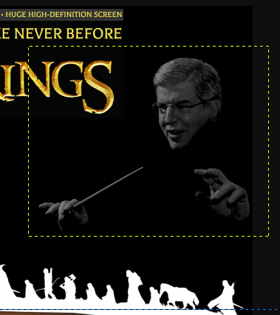
Seventh, Adding Howard Shore continued

Slide 17
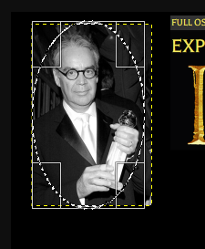
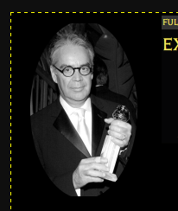
Seventh, Adding Howard Shore continued
Now for the second photo of Howard Shore.
Open it as a layer and move it to the top left area, left of the title.
Let’s make it a bit grey. Color menu->Desaturate. Then choose whichever looks best.
After that, crop the layer so it is rounded by select inverting a eclipse tool selection. Then clearing so only Howard Shore remains. Remember to auto crop the layer.

Slide 18
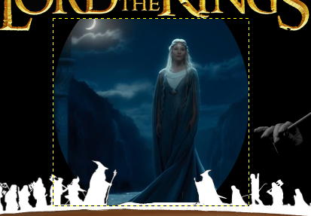
Eighth, Adding Lady Galadriel
Adding Lady Galadriel should be an easy eclipse select and invert job just like for Howard Shore. This time, being a focus piece of the poster, we will leave the color alone.
In lining up the image, use the center vertical guide and place the layer top between the “L” and “S” of the title. As well as place the bottom of the layer behind the silhouettes. You will have to scale the image to do so. I set it to 522x498. Your cut out shape will make the scale size differ.

Slide 19
Ninth, Optional increase red of the One Ring
I was unsatisfied with the bland redness of the words flaming on the ring. So I used the Paths tool to select just the ring and not the map and then increased the red flame look. Not the best, but better I think.
After setting the selection with the Paths tool, goto Tools->Color Tools->Color Balance. Within here, play around with the Highlights & Red. Then do the same with Midtones. Just a tad more red on each and we can get some eye candy for our poster.

Slide 20
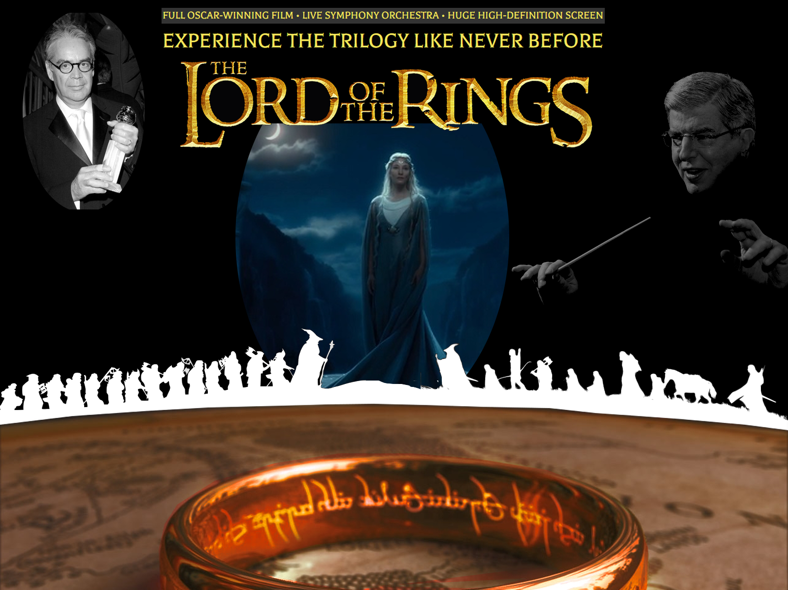
Complete!

